Slide 1
CVS pharmacy
Final Project
By
Ivor Leon

Slide 2
Objective
To design a system that will reduce the number of products that are out of stock in the warehouse and also reduce the number of products that are not readily available on the shelf for customers.
To design an innovative system that would increase the Sales Revenue.

Slide 3
What we will discuss today.
Why I picked this objective?
What is my proposed system?
How will my proposed system achieve my objectives?
What are the benefits of my proposed system?

Slide 4
Why I picked this objective
Simply because of Customer Focused Replenishment (CFR) – it’s a THINK CUSTOMER mindset designed to improve the customer’s in-stock experience by ensuring that the product is in the home location – where the customer is most likely going to shop. CFR is based on 3 key concepts:
Replenish the Sales Floor
Perform Regular Backroom Maintenance
Maintain BOH Accuracy
My proposed system will make it much easier to accomplish all 3 concepts

Slide 5
Why I picked this objective Cont…
The stores I have visited so far all have one problem in common – products not on shelf for customers to buy.
For example – when I went with the District Manager Derrell for a district travel, one of our customers walked up to Derrell and complained about how they don’t have items on shelf very often.
Let’s see some pictures from the store that I was working at.

Slide 6
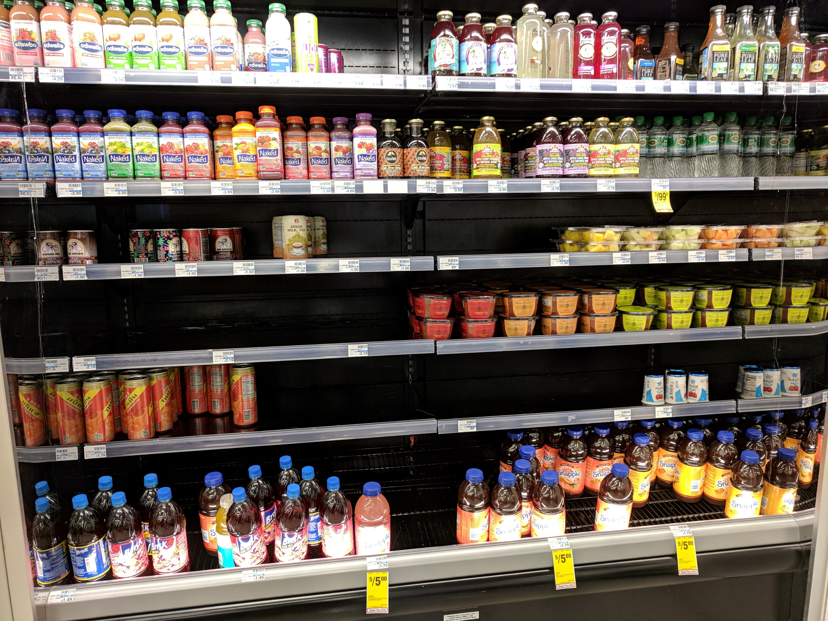
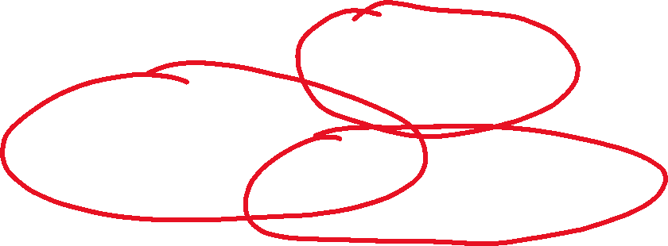
Why I picked this objective Cont…

Slide 7
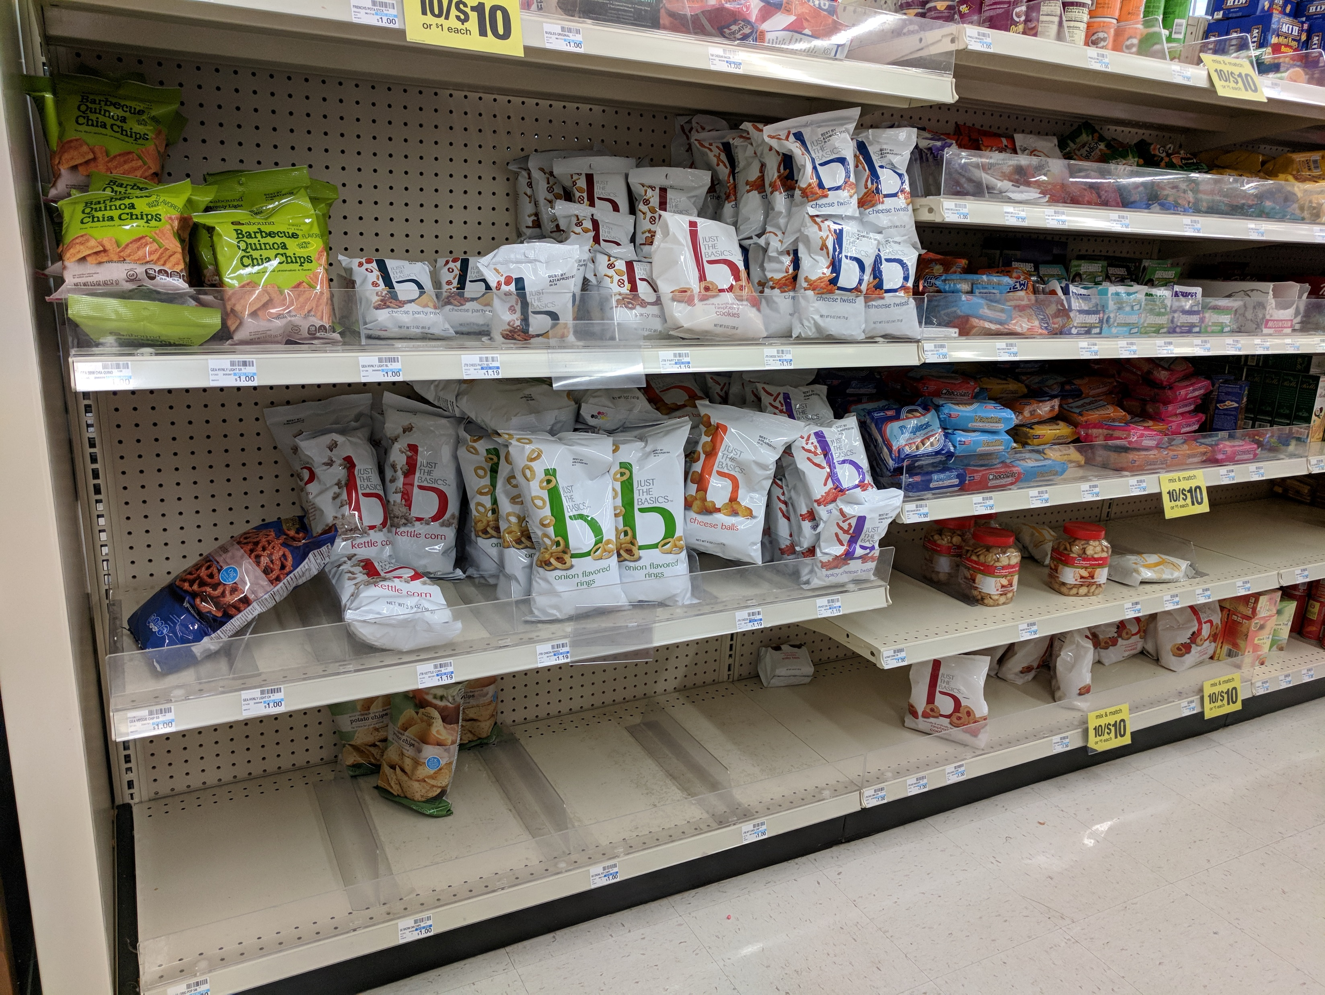
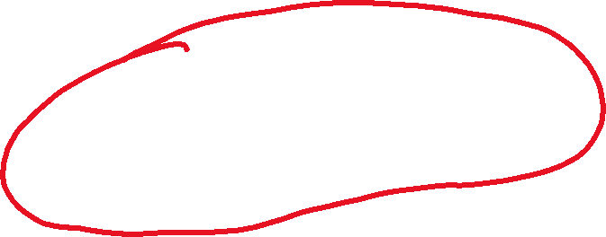
Why I picked this objective Cont…

Slide 8
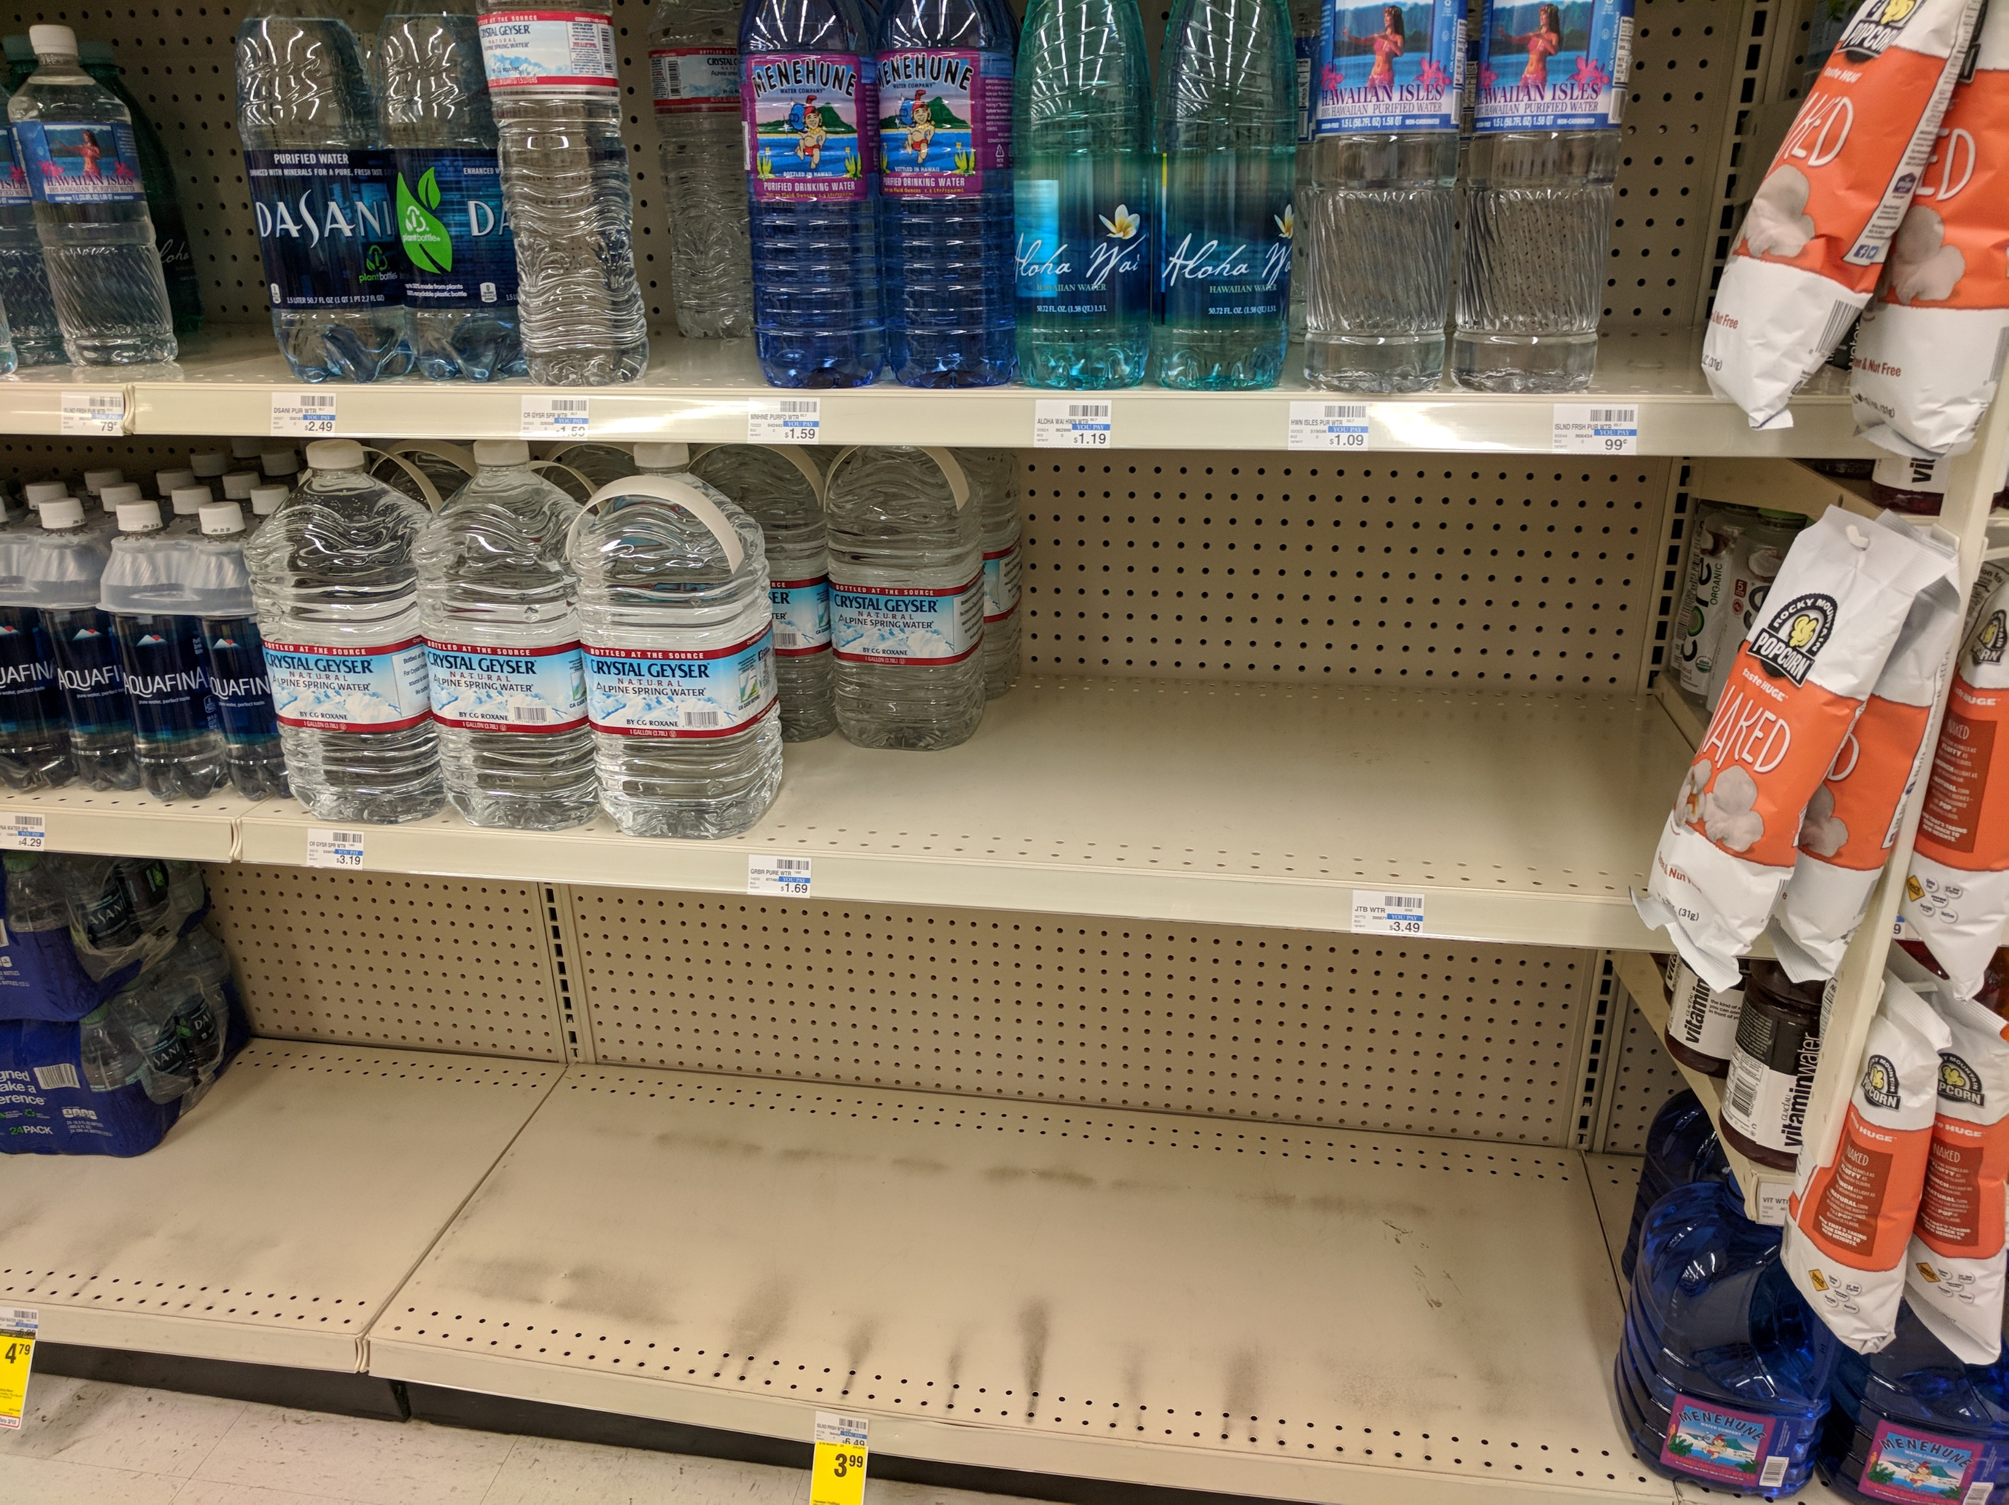
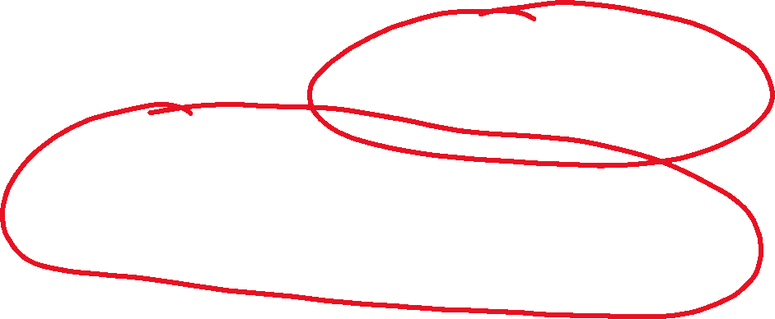
Why I picked this objective Cont…

Slide 9
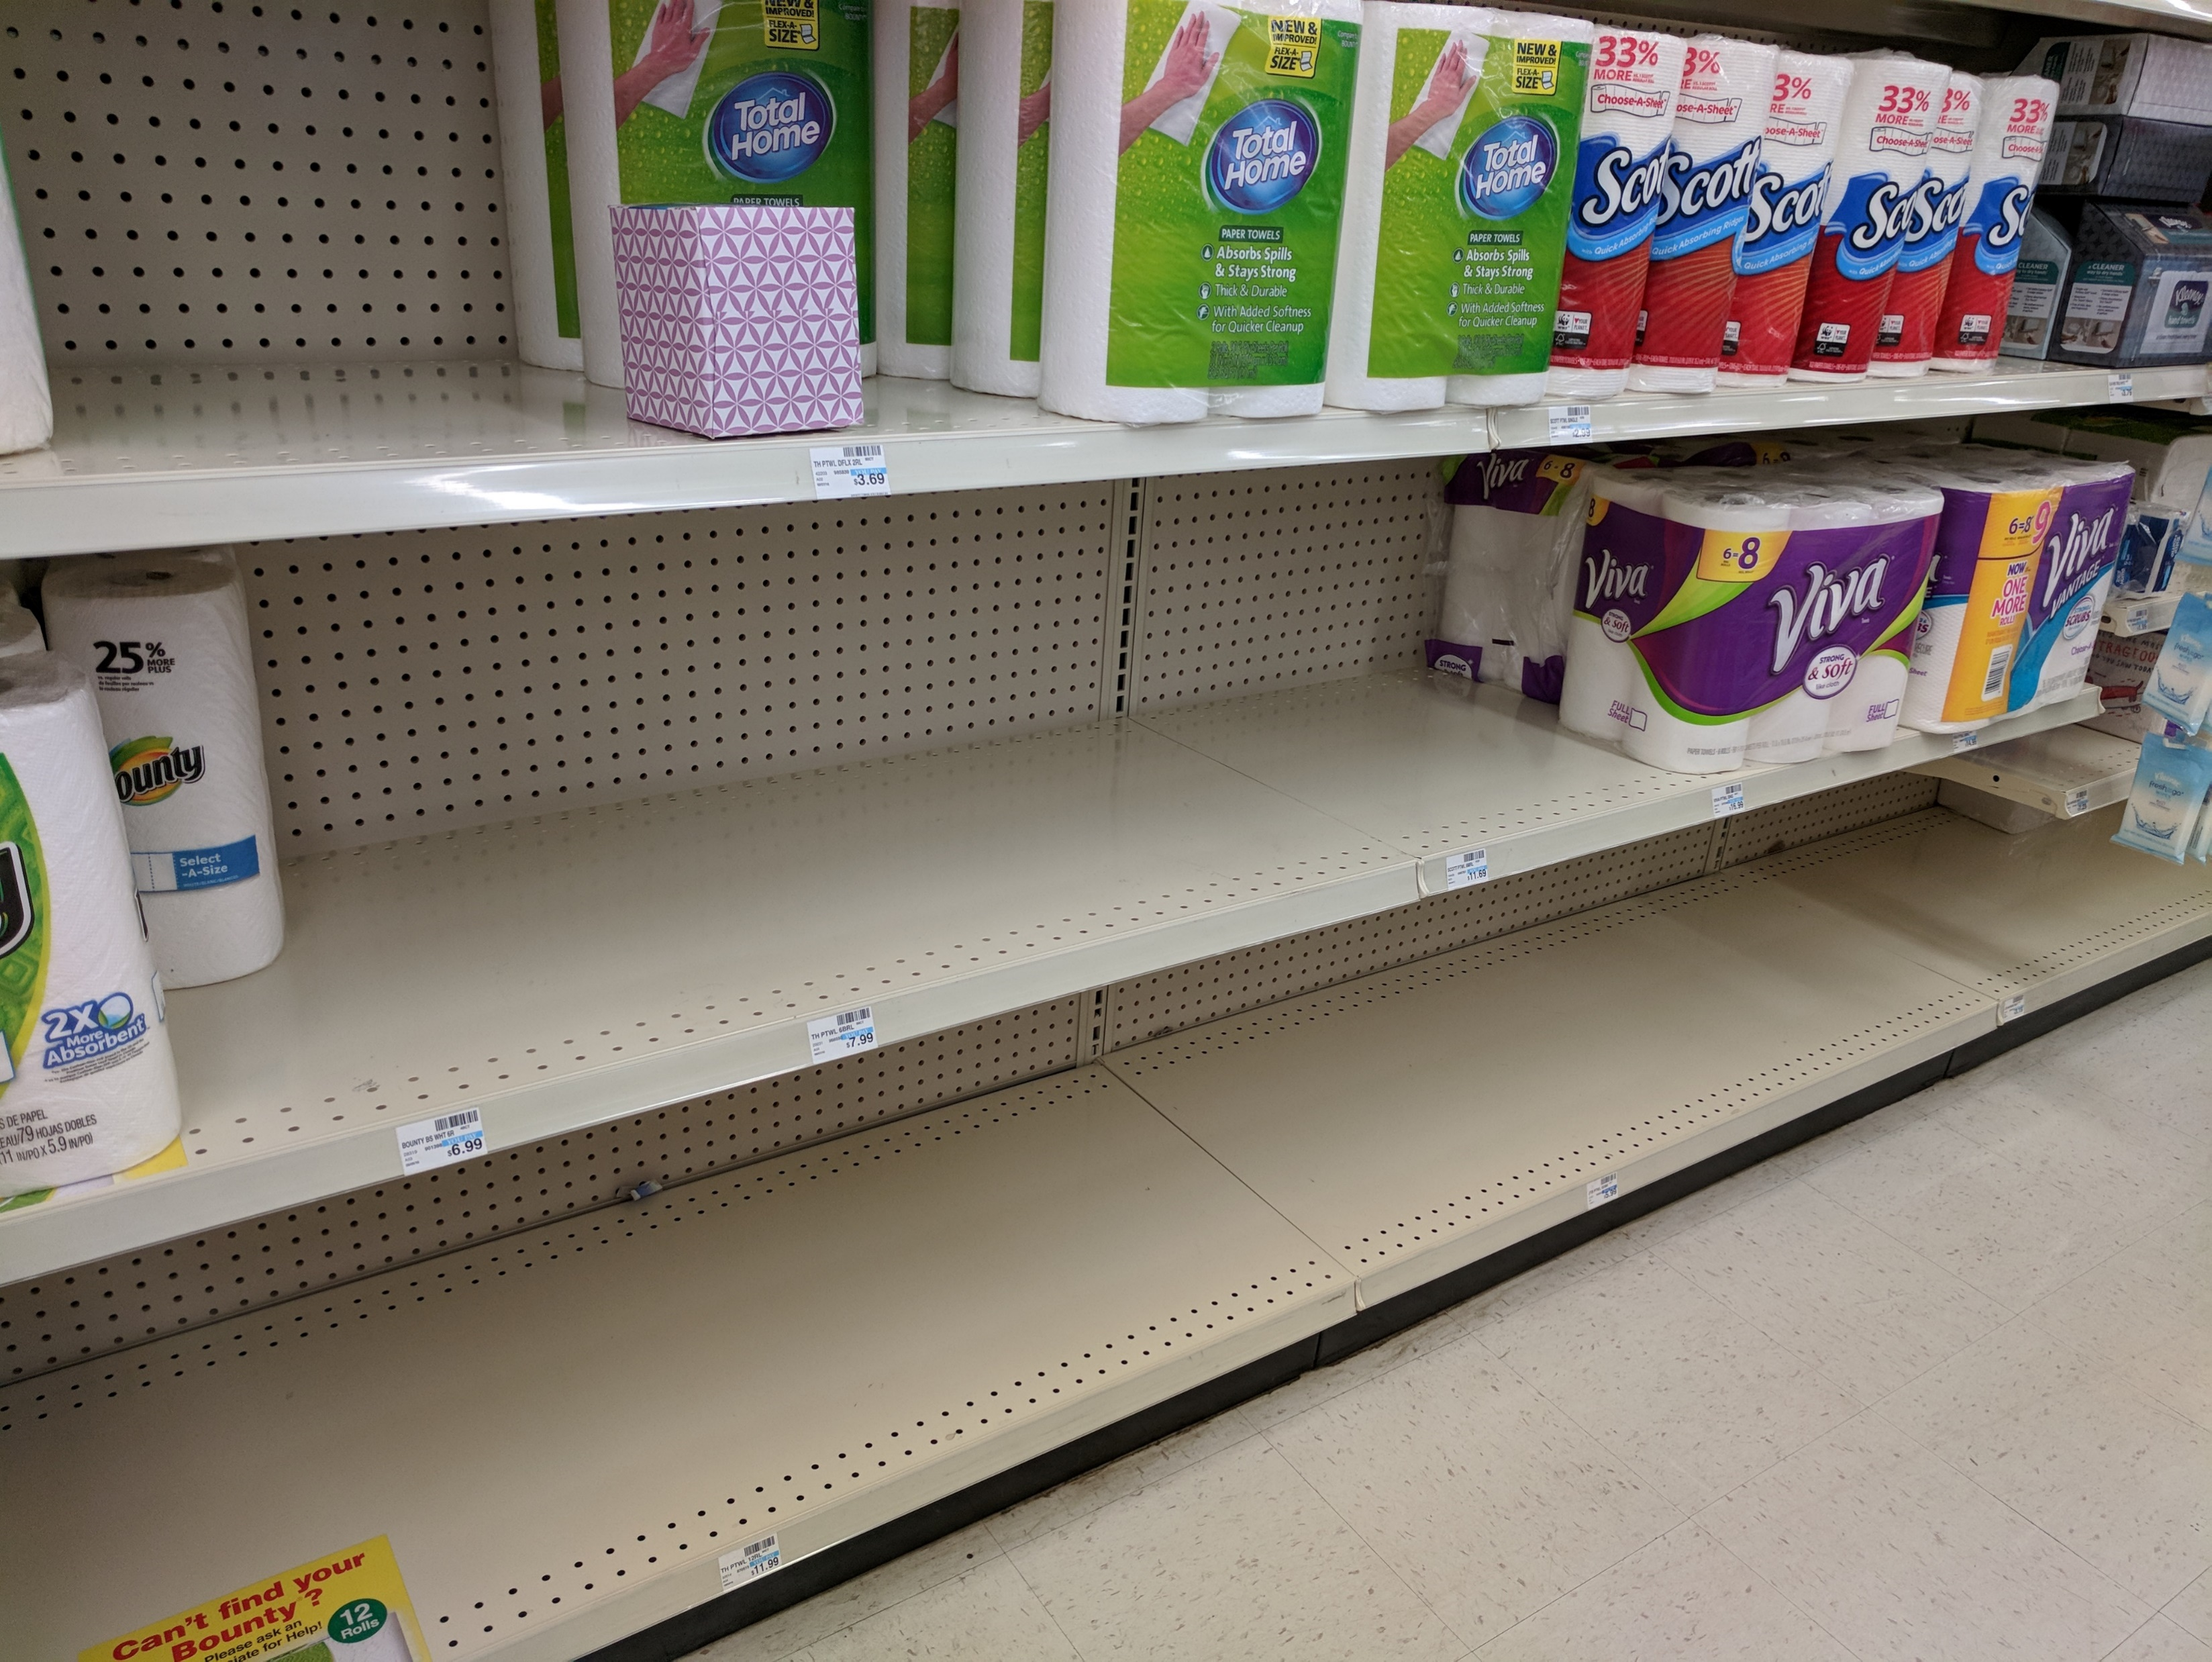
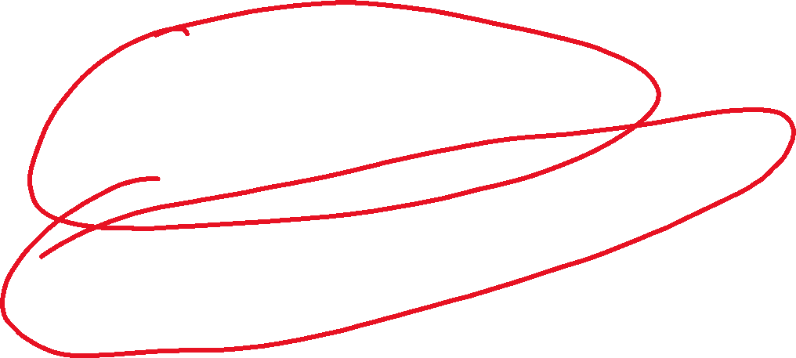
Why I picked this objective Cont…

Slide 10
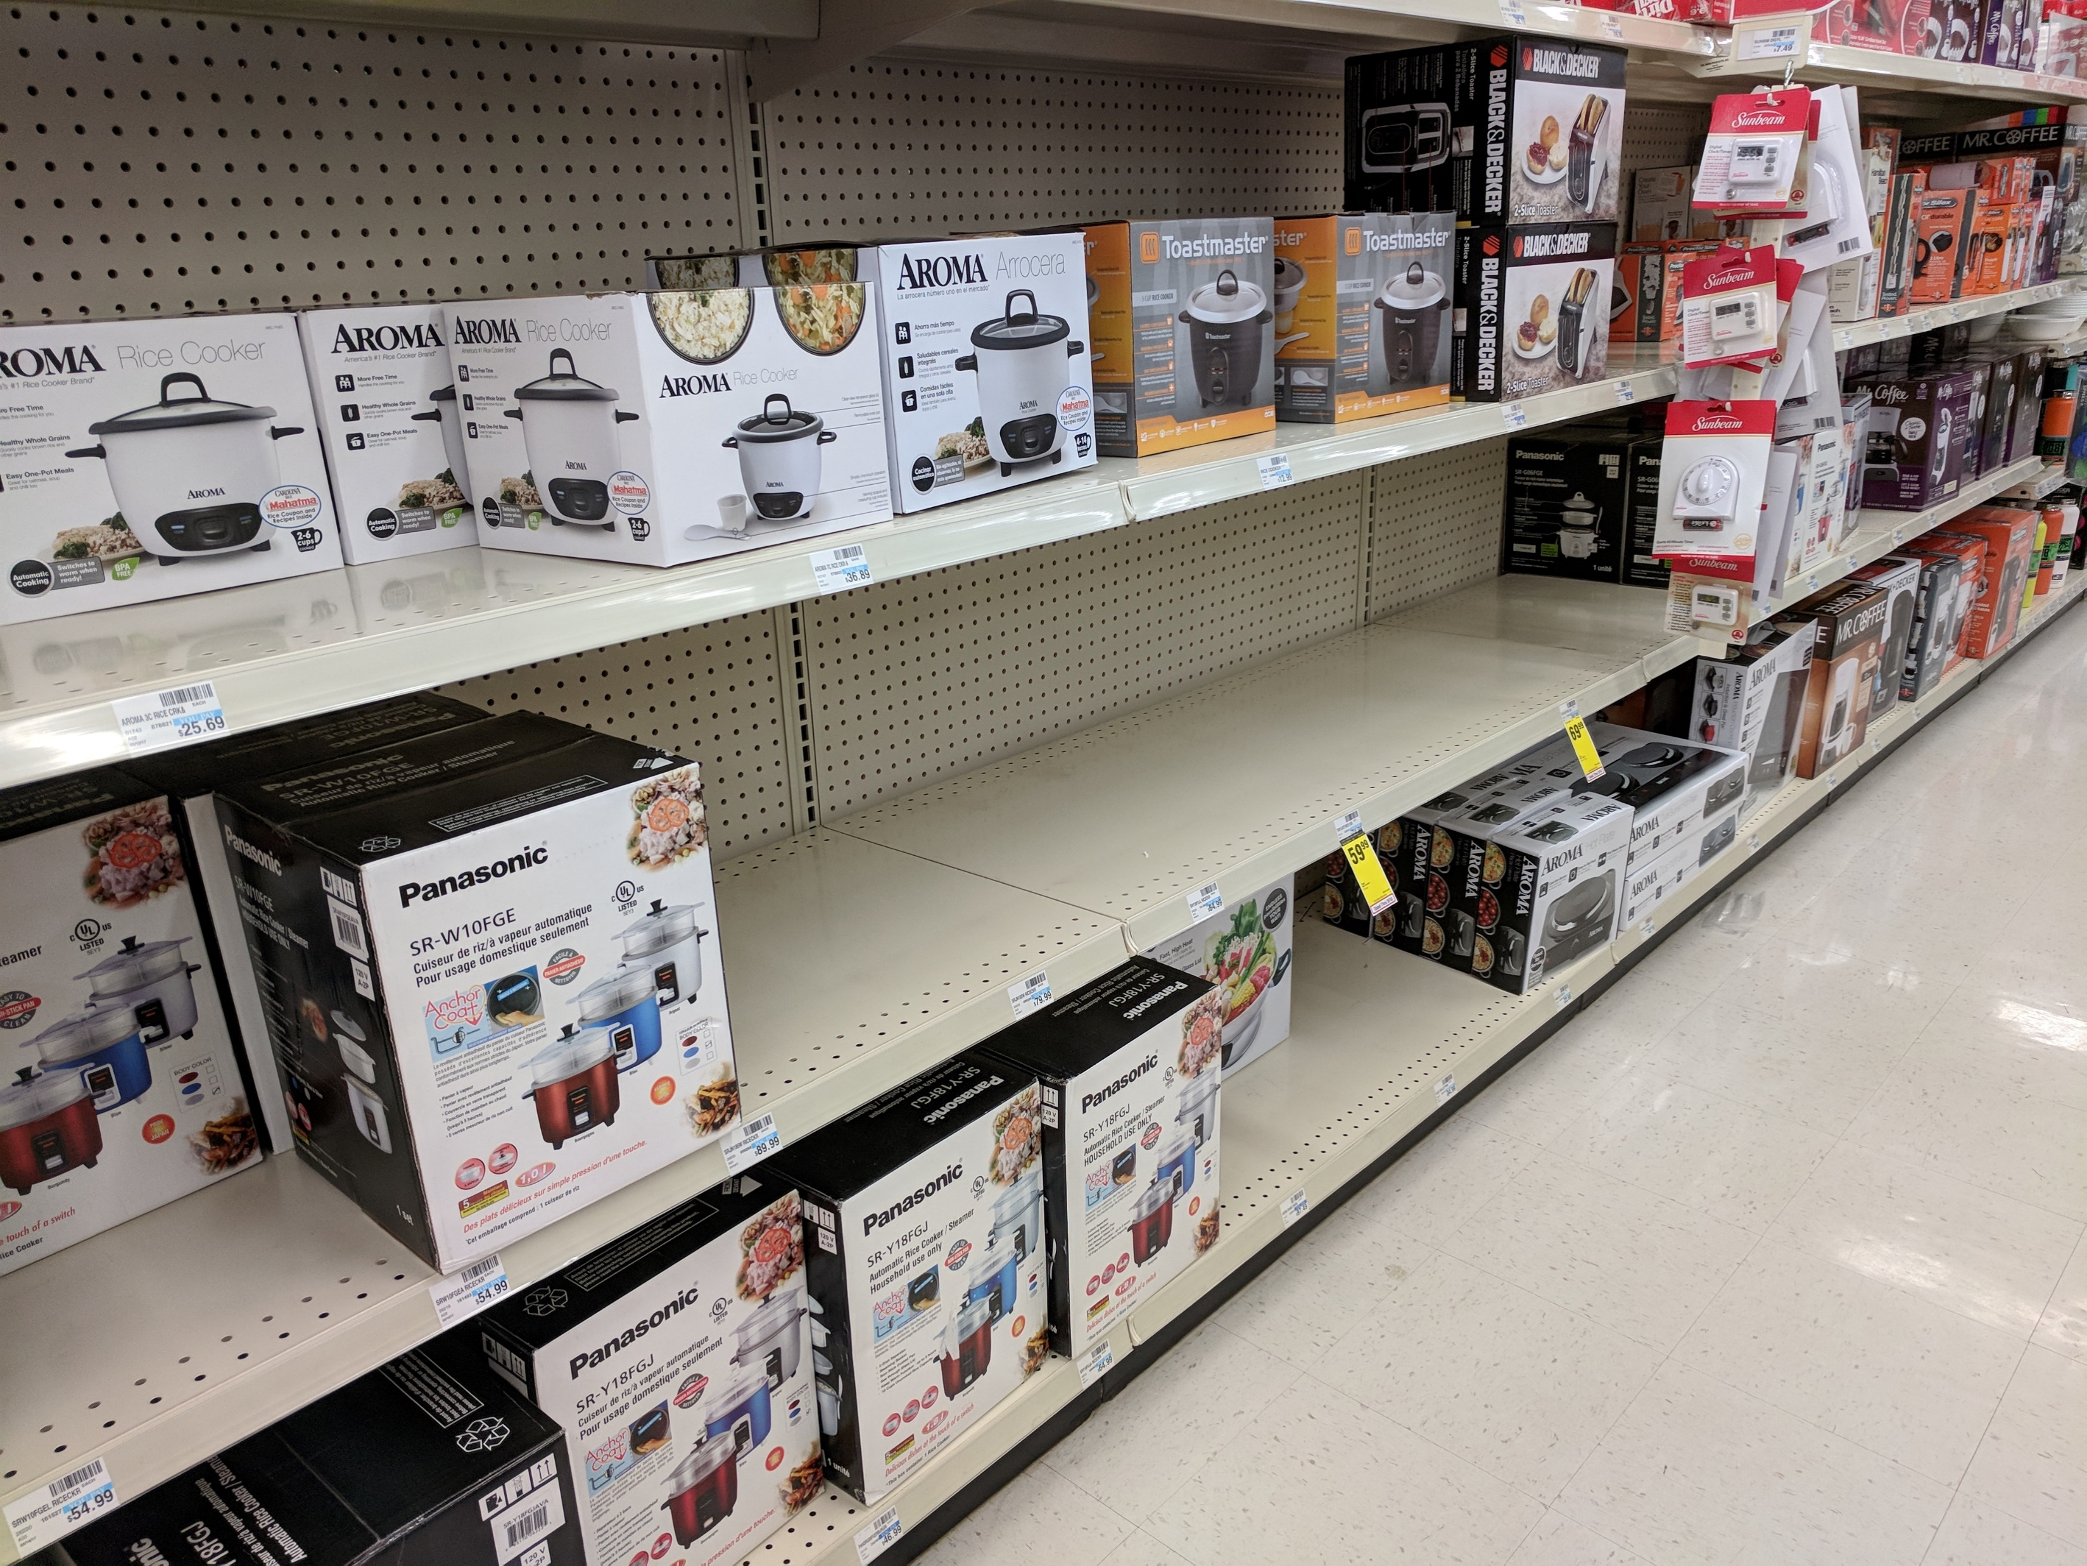
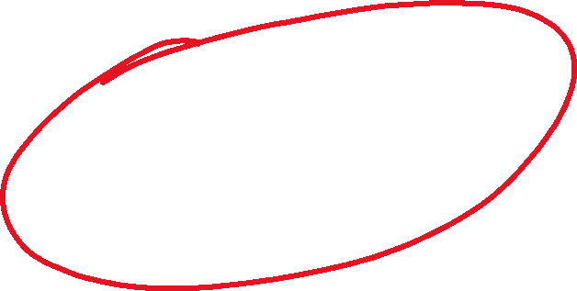
Why I picked the first objective Cont…

Slide 11
Why I picked this objective Cont…
It may be that the vendor has not showed up, may be the order was not placed on time to have it delivered before we ran out of stock, or may be simply because we don’t sell that product any more.
Regardless of the reason as to why we don’t have these products on shelf, this creates a very bad impression among customers.
A customer’s mind would be that this store doesn’t have enough products to meet customer demand. Should I continue to shop here in future.
A potential loss of a customer to our competitor.

Slide 12
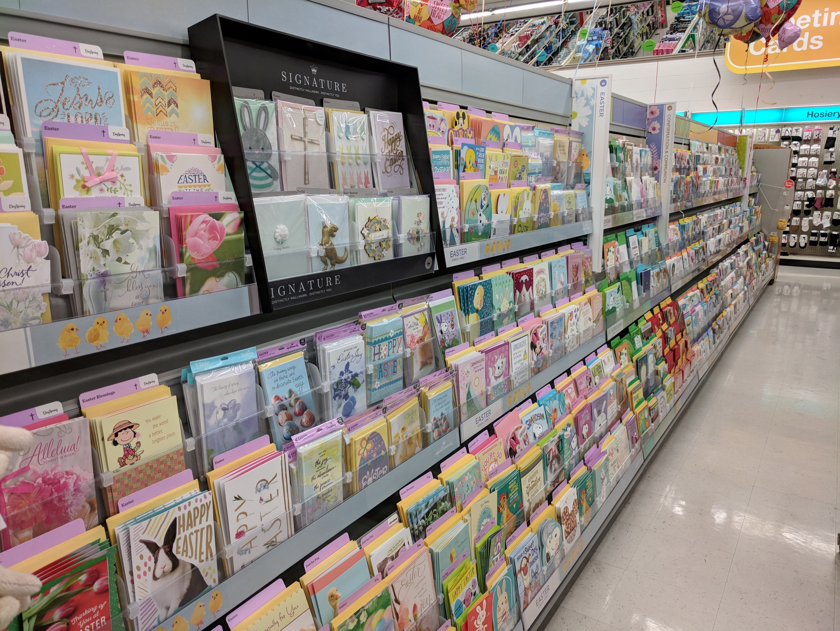
Why I picked this objective Cont…
A perfect aisle

Slide 13
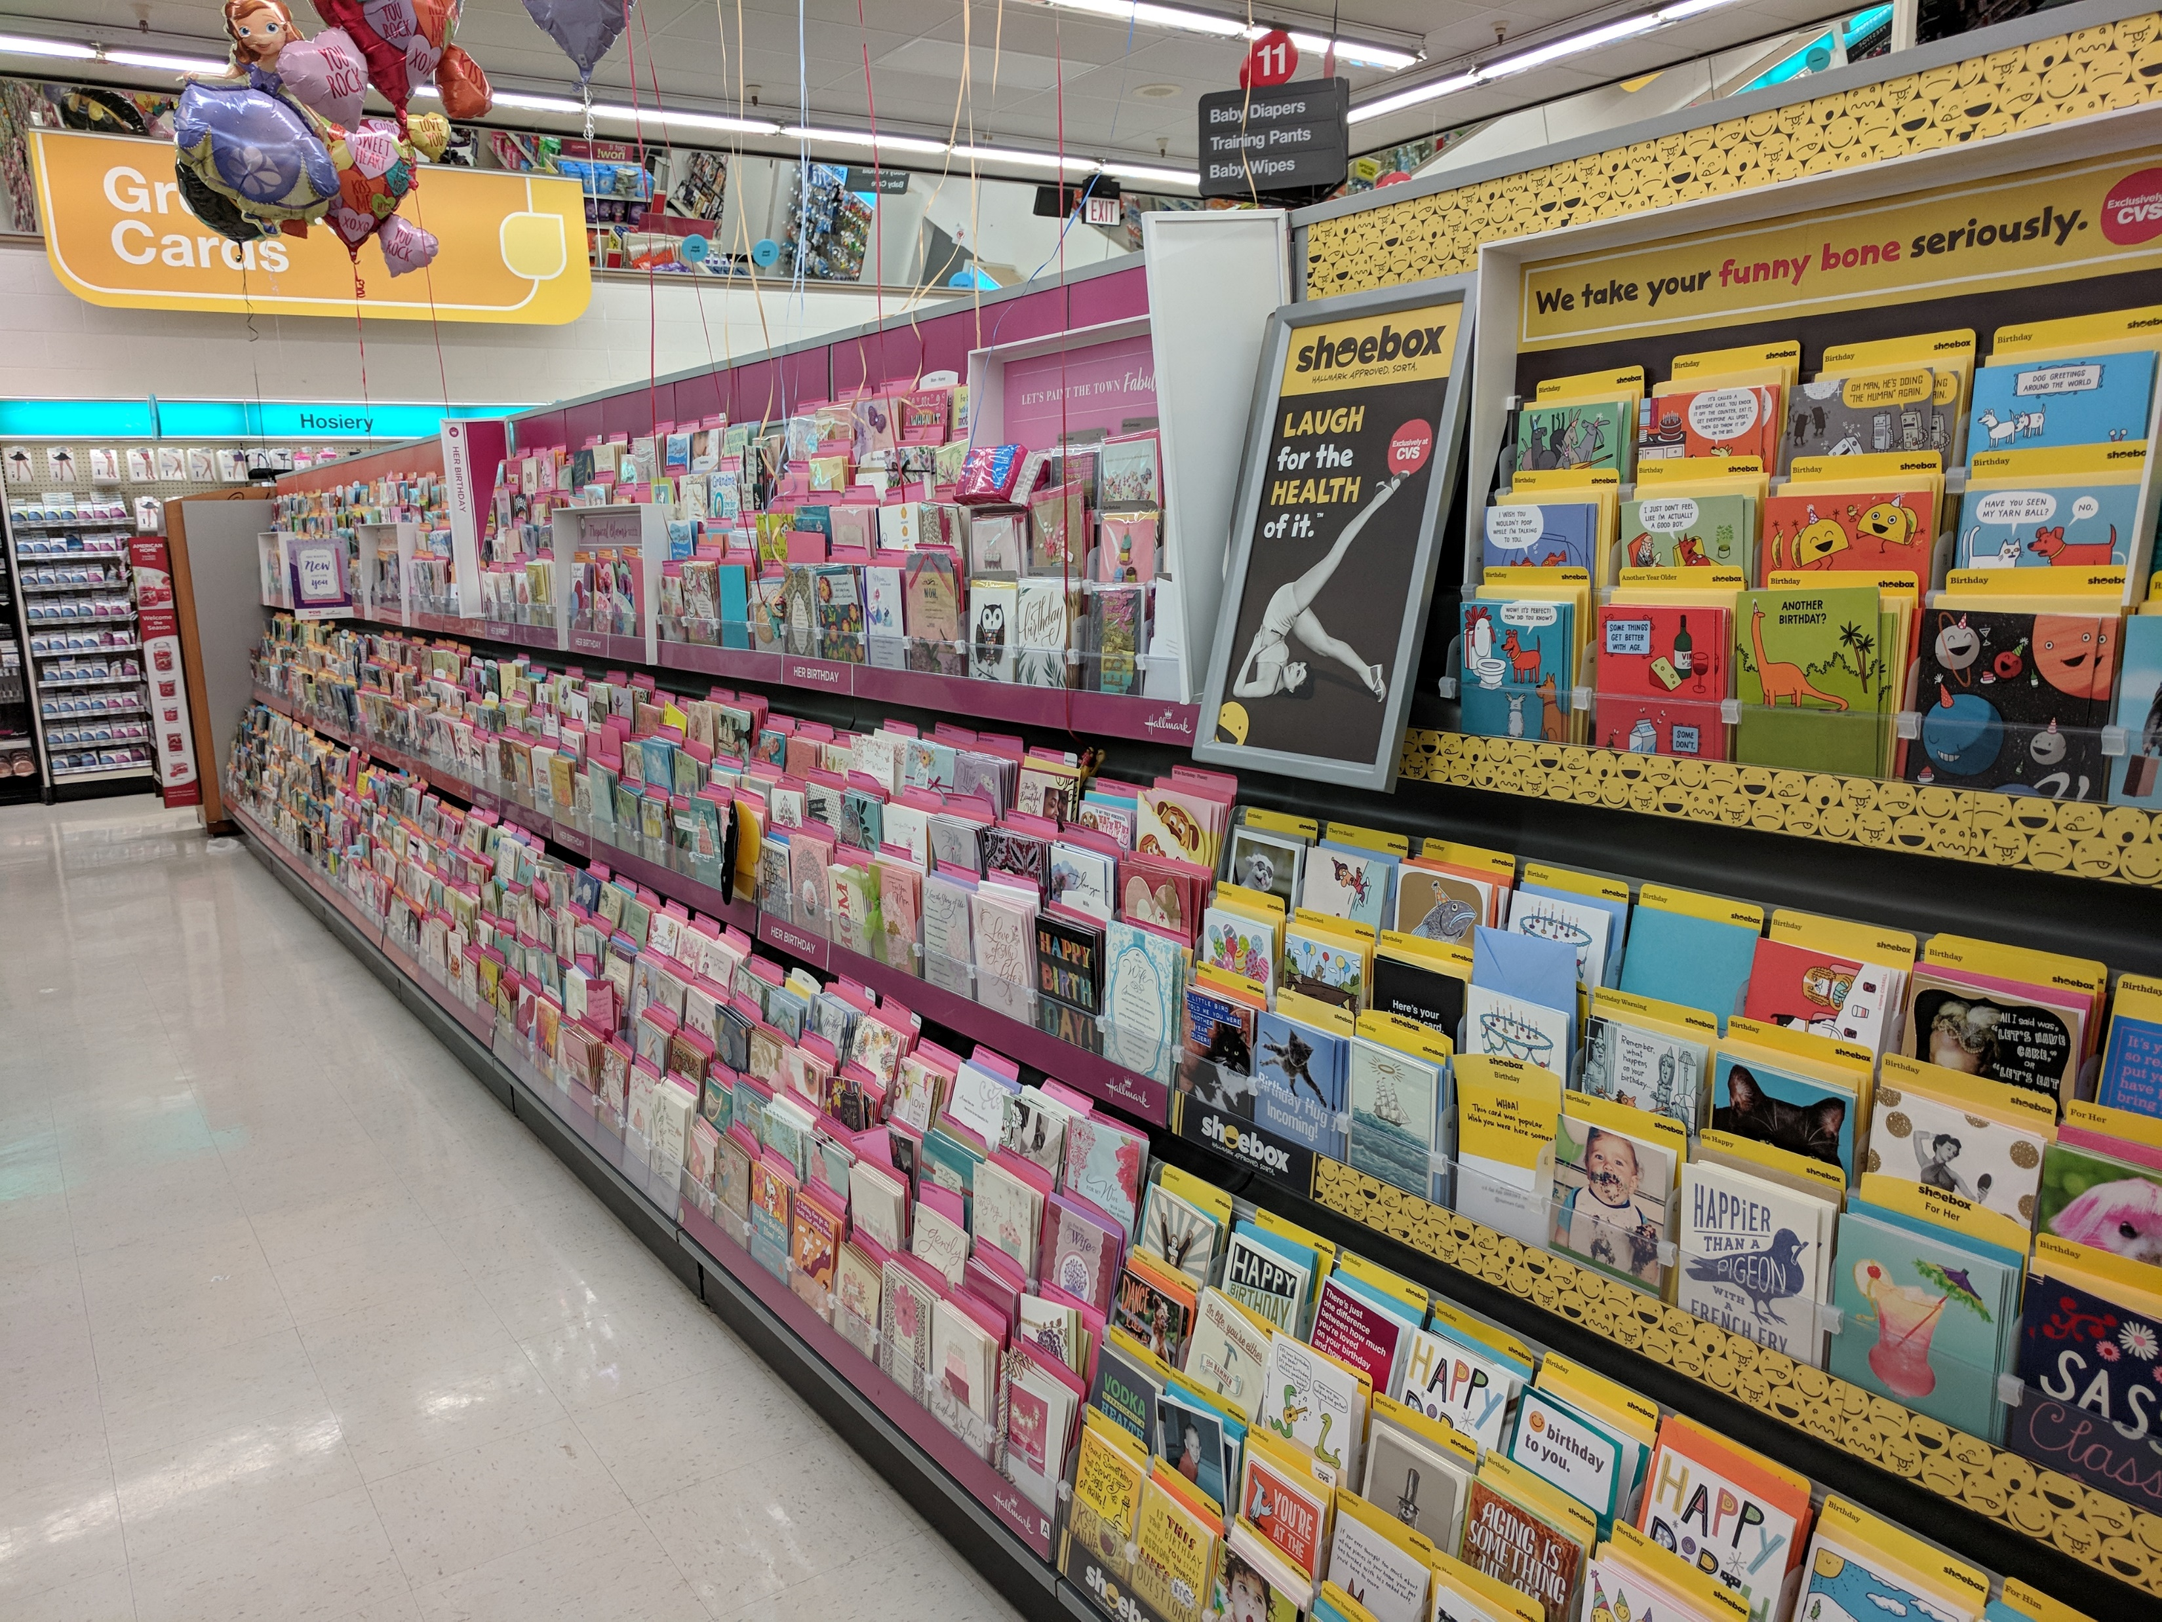
Why I picked this objective Cont…
A perfect aisle

Slide 14
Why I picked this objective cont…..
Last month my stores budgeted sales were reduced by 5%. Even the previous month the budgeted sales were reduced.
One of the stores I visited had their budgeted hours from 700+ previous month to 400+ that month. That tells me their budgeted sales must have reduced dramatically.
It seems that the sales revenue in our region may continue to reduce as competition grows.
Therefore my objective is to design a innovative system that would increase the Sales Revenue.

Slide 15
What is my Proposed System?
First we will re-create our store level database.
The database will be in real time and will be accessible to the store managers via the computer and store tablet.
The database will continue to contain all the current attributes that we have now, plus I will add more attributes that will help us achieve Customer Focused Replenishment.
We will take a look at the new database next.

Slide 16
What is my Proposed System? Cont…
Products Table
These new attributes will be a great help to achieve my objective
Product ID | Category | ****** | Shelf Buffer Limit | No. of Items on Shelf | No. of items in Backroom | Buffer Limit | Total

Slide 17
What is my Proposed System? Cont…
Shelf Buffer Limit – this will be the minimum number of items on shelf at any given time. Goal is to make sure we don’t go below this number. This number is calculated based on the past sales data. This is the projected number of items sold per day.
No. of Items on Shelf – this will be the number of items currently on shelf.
No. of items in Backroom – this will be the number of items currently in the backroom.
Buffer Limit – this will be the minimum total number of items in the store. Buffer Limit = Shelf Buffer Limit * Number of days it takes the supplier to deliver the items
Total – number of items on Shelf + number of items in the Backroom
Keep in mind, all these attributes are updated in real time, not at the end of the day.

Slide 18
The current system
Currently the database will is not in real time and is not accessible to the store managers via the computer and store tablet.
Currently in order to prevent the shelfs been out of stock, the store uses a Red Cart system.
Every cart has a different category of items and once every 2 weeks an employee will take the red cart to the floor to fill in the shelfs.
I believe we could have a much better and more efficient way of stocking the shelves using todays technology.

Slide 19
How will this system work and how does it benefit the store.
Assume this is the current status of a product
Based on the past sales data, assume our projected number of items sold per day is 2. So that would be our Shelf Buffer Limit.
Lets assume that it takes 5 days for the vendor to deliver the product, after an order has been placed, therefore our Buffer Limit is 10 (2*10).
Product ID | Category | ***** | Shelf Buffer Limit | No. of Items on Shelf | No. of items in Backroom | Buffer Limit | Total
1234 | VITAMINS | ****** | 2 | 4 | 10 | 10 | 14

Slide 20
How will this system work and how does it benefit the store.
A customer buys 2 bottles of that product.
As soon as the cashier rings the item at the counter the number of Items on Shelf will automatically be deducted from the database in real time.
Product ID | Category | Shelf Buffer Limit | No. of Items on Shelf | No. of items in Backroom | Buffer Limit | Total
1234 | VITAMINS | 2 | 4 | 10 | 10 | 14
1234 | VITAMINS | 2 | 2 | 10 | 10 | 12

Slide 21
How will this system work and how does it benefit the store.
As you can see from the previous slide, the number of Items on Shelf has reached the Shelf Buffer Limit.
At this time the system will send a notification the Management Team with all the product details requesting to add more items on the shelf up to the maximum it can hold.
The notification will be accessible by the store tablet as well, so supervisors can use the tablet to go around the warehouse and collect all items that need to be stocked.
Lets assume the shelf can hold up to 8 bottles, so when re-stock the shelf every item will be scanned before it is placed on the shelf.
This step is imperative to make sure that our database is accurate at any given time. This will minimize the Balance on Hand inaccuracy.

Slide 22
How will this system work and how does it benefit the store.
Lets now look at the current database after the items have been scanned and stocked on the shelf.
Product ID | Category | Shelf Buffer Limit | No. of Items on Shelf | No. of items in Backroom | Buffer Limit | Total
1234 | VITAMINS | 2 | 2 | 10 | 10 | 12
1234 | VITAMINS | 2 | 8 | 4 | 10 | 12

Slide 23
How will this system work and how does it benefit the store.
The next day the store sells 2 more of the same product.
Now lets take a look at what happens next.
The Total items in Store has reached the buffer limit 10.
Our projected sales per day for this product is 2, therefore now we only have enough stock to sell for the next 5 days. Time to re-order.
Product ID | Category | Shelf Buffer Limit | No. of Items on Shelf | No. of items in Backroom | Buffer Limit | Total
1234 | VITAMINS | 2 | 8 | 4 | 10 | 12
1234 | VITAMINS | 2 | 6 | 4 | 10 | 10

Slide 24
How will this system work and how does it benefit the store
As you can see from the previous slide the Total items in Store has reached the Buffer Limit.
At this time the system will check the database for any orders currently pending for this product, to avoid duplicate order.
If there are no pending orders, the system will send a notification to the Management Team with all the product details requesting to contact vendor to place an order.

Slide 25
How will this system work and how does it benefit the store
As you can see how efficient this system would be, than the current system the store has in place.
I believe that with this system in place, we can dramatically reduce the number of products that are out of stock in the warehouse and also reduce the number of products that are not readily available on shelf for customers.
If products are readily available on the shelf for customer to buy, it will increase the Sales Revenue and also will create a good impression among the customers and have them return to the store in future.

Slide 26
Questions?

